Slide 1
Cohesive Devices
Coherence in writing means achieving a consistent relationship among parts.
Cohesive devices show the logical relationships between the various parts of an essay as well as between sentences and paragraphs.
Cohesive devices include:
transitional words and expressions,
paragraph hooks

Slide 2
What are they?
cohesive devices are like bridges between parts of your paper
They are cues that help the reader to interpret ideas in the way that you, as a writer, want them to understand

Slide 3
What do they do?
cohesive devices help you carry over a thought from one sentence to another, from one idea to another, or from one paragraph to another with words or phrases.
cohesive devices link your sentences and paragraphs together smoothly so that there are no abrupt jumps or breaks between ideas.

Slide 4
Why do you use them?
cohesive words and phrases are used to link sentences and paragraphs, to show which direction your thought patterns are going, to help the reader accurately follow your train of thought.
They signal the relationships among the various parts of your subject.

Slide 5
Types:
There are several types of cohesive devices, and each category leads your reader to make certain connections or assumptions about the areas you are connecting.
Some lead your reader forward and imply the "building" of an idea or thought,
while others make your reader compare ideas or draw conclusions from the preceding thoughts.

Slide 6
To signal relation in time:
Before, meanwhile, later, soon, at last, earlier, thereafter, afterward, by that time, from then on, first, next, now, presently, shortly, immediately, finally

Slide 7
To signal similarity:
Likewise, similarly, once again, once more

Slide 8
To signal difference:
But, yet, however, although, whereas, though, even so, nonetheless, still, on the other hand, on the contrary

Slide 9
To signal consequences:
As a result, consequently, therefore, hence, for this reason

Slide 10
Example:
I knew my dieting had gotten out of hand, but when I could actually see the movement of my heart beating beneath my clothes, I knew that I was in trouble. At first, the family doctor reassured my parents that my rapid weight loss was a “temporary phase among teenage girls.” However, when I, at fourteen years old and five feet tall, weighed in at 63 pounds, my doctor…

Slide 11
Paragraph Transitions
Transition words are audience cues that help the reader shift from one paragraph to the next.
These connections between paragraphs help the reader see the relationships of the various parts.
Transition words or phrases at the beginning of a new paragraph—such as first, second, next, another, finally, on the other hand, however—show the reader where the essay is going next.

Slide 12
Paragraph hooks:
In addition to transition words, writers often tie paragraphs together by repeating a key word or idea from a previous paragraph in the opening sentence of the next paragraph.
This “hooks” the paragraphs together, creating for the reader a logical flow of thought.

Slide 13
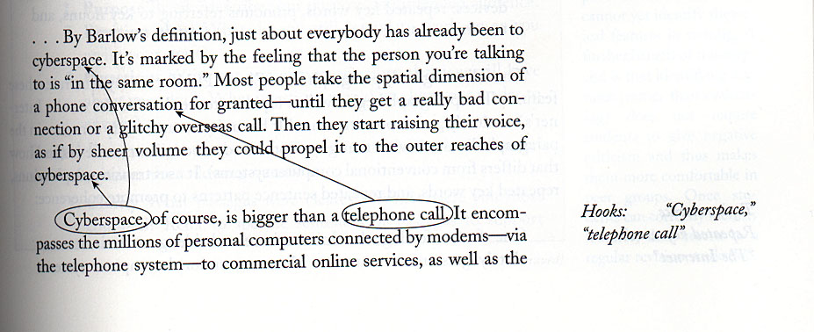
For example:

Slide 14
